Slide 1

The Role of Technology
Chapter 11
©2020 McGraw-Hill Education. All rights reserved. Authorized only for instructor use in the classroom. No reproduction or further distribution permitted without the prior written consent of McGraw-Hill Education.

Slide 2
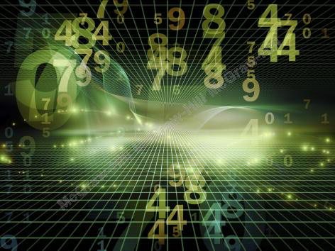
Technology Defined
Technology: A broad term referring to the practical applications of science and knowledge to commercial and organizational activities.
Notes:
Technology: A broad term referring to the practical applications of science and knowledge to commercial and organizational activities.
Change is the dominant feature of technology:
Sometimes the pace of change is so fast and furious that it approaches the limits of human tolerance.
Technology’s effects are widespread:
Ripples through society until every community is affected.
Technology is self-reinforcing:
Acts as a multiplier to encourage its own faster development.

Slide 3
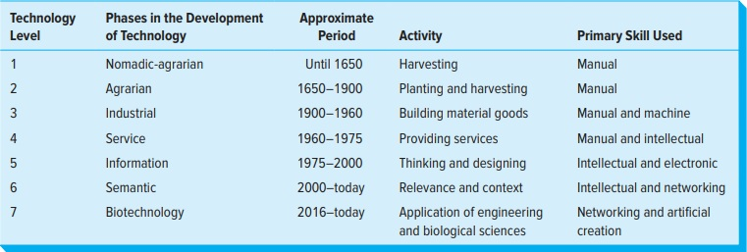
Phases in the
Development of Technology
Figure 11.1
Copyright © McGraw-Hill Education. Permission required for reproduction or display.
Access the text alternative for these images.

Slide 4
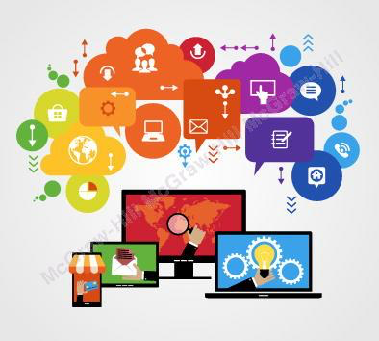
The Role of Technology in Our Daily Lives
The Internet
Behavioral addiction
Spam
Phishing
Notes:
The Role of Technology in Our Daily Lives2
The Internet
One of the most visible and widely used technological innovations over the past decade has been the Internet.
Enable users to share information along multiple channels linking individuals and organizations.
In 2008, China surpassed the United States with the most Internet users by country.
By 2017, India surpassed the United States and Japan for second largest number of Internet users.
Behavioral addiction
A compulsion to engage in rewarding behaviors, despite negative consequences.
Technology manufacturers are accused of contributing to the increasing behavioral addiction to technology.
Some countries are considering “Cinderella Laws,” to protect children from playing certain games after midnight.
Spam: unsolicited commercial e-mails (UCE or junk e-mails) sent in bulk to valid e-mail and mobile accounts.
It has caused extra network traffic and wasted time sorting through the irrelevant or unwanted e-mails to access desired messages.
U.K. and the U.S. have anti-spam legislation.
Phishing: The practice of stealing consumers’ personal identity data and financial account credentials by using fake e-mails.

Slide 5
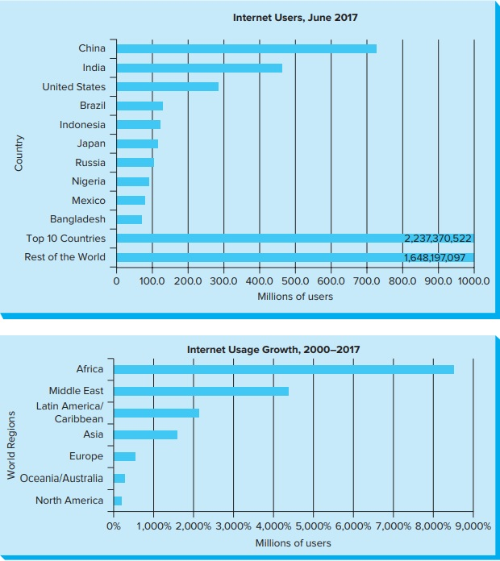
Top 20 Internet Users by Country, 2017
Copyright © McGraw-Hill Education. Permission required for reproduction or display.
Figure 11.2
Access the text alternative for these images.

Slide 6
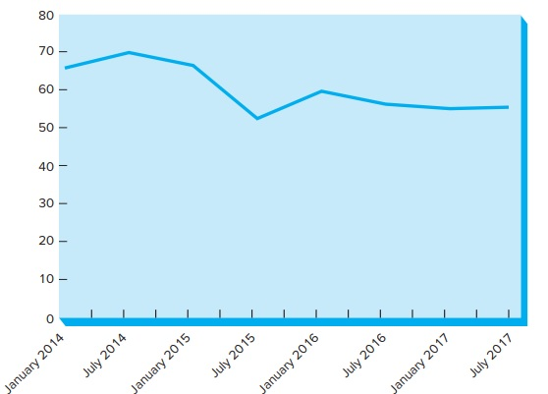
Global Spam Volume
Figure 11.3
Copyright © McGraw-Hill Education. Permission required for reproduction or display.
Access the text alternative for these images.

Slide 7

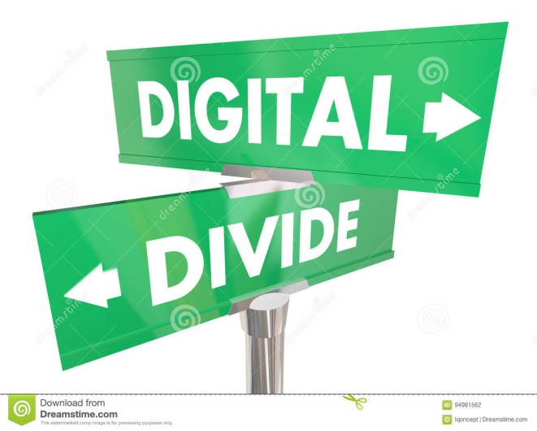
The Digital Divide in the United States and Worldwide1
Digital divide
Mobile Telephones
M-commerce
Notes:
Digital divide: Gap between those that have technology and those that do not.
Problem: less advantaged individuals and societies may not enjoy the same benefits of technology as others.
Argument: Mobile broadband access isn’t the same as at-home connectivity.
By 2013, nearly 98 percent of American homes were able to access the Internet on some sort of high-speed broadband network, either at home or work.
By 2017, more than 52 percent of people on the planet still did not have Internet access.
The average global Internet speed was 7.7 megabits per second (Mbps).
Mobile Phones Use radio technology to enable users to place calls from a mobile device, with transmission over a service area divided into small “cells,” each with its own low-power radio transmitter.
M-commerce: conducted via mobile or cell phones, allows consumers to use their mobile phones as an electronic wallet.

Slide 8
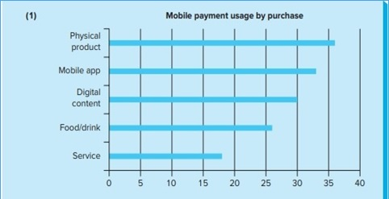
Mobile Payments1
Figure 11.4 (1)
Copyright © McGraw-Hill Education. Permission required for reproduction or display.
Access the text alternative for these images.

Slide 9
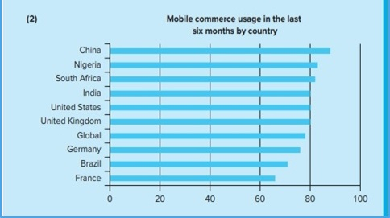
Mobile Payments2
Figure 11.4 (2)
Copyright © McGraw-Hill Education. Permission required for reproduction or display.
Access the text alternative for these images.

Slide 10
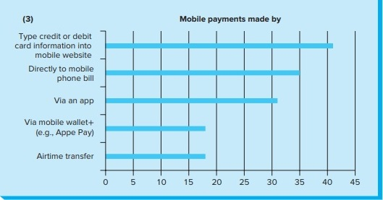
Mobile Payments3
Figure 11.4 (3)
Copyright © McGraw-Hill Education. Permission required for reproduction or display.
Access the text alternative for these images.

Slide 11

Social and Ethical Aspects
Social networking
Loss Of Privacy
Free Speech Issues
Government censorship of free speech
Notes:
Social networking: a system using technology to enable people to connect, explore interests, and share activities around the world, exploded on to the technology scene in the 2000s, altering many social and human interactions.
Raises additional responsibilities to ensure that the interactions are ethical and socially beneficial.
The Loss of Privacy
Individuals are under a technology microscope with vast amounts of data collected each minute and available to be analyzed in great detail.
In 2014, a law was introduced in the U.S. that would require car owners to control the data collected on the device called the event data recorder, commonly known as a black box.
Free Speech Issues
→ Examples:
Anthony Elonis was accused of threatening his estranged wife based on a series of Facebook posts.
FB Anon was shut down after Facebook found that the group violated the site’s terms of service by posting racist and sexist comments anonymously.
Government censorship of free speech
In democratic countries, the role of government is more likely to look out for the public good and protect intellectual property.
In some nondemocratic or authoritarian societies, governments have attempted to limit their citizens’ access to the Internet based on political, security, and religious grounds.
→ Examples:
China.
Pakistan.
Iran.
North Korea.

Slide 12
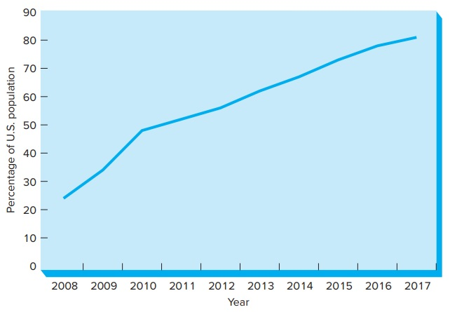
Americans with a Social Profile, 2008-2017
Copyright © McGraw-Hill Education. Permission required for reproduction or display.
Figure 11.5
Access the text alternative for these images.

Slide 13
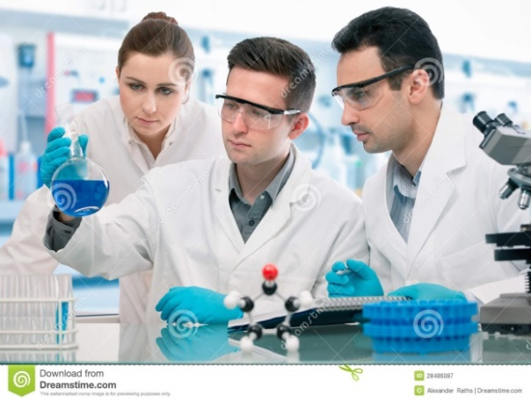
The Impact of Scientific Breakthroughs1
Some of the most profound impacts on our lives come from scientific breakthroughs:
  Genetically modified or engineered foods:
    Involves altering the natural makeup of a living organism and allowed scientists to insert virtually any gene into a plant and create a new crop or a new species.
  The sequencing of the human genome and the use of genetic information:
    The identification of human genes is critical to the early diagnosis of life-threatening diseases, the invention of new ways to prevent illnesses, and the development of drug therapies to treat a person’s unique genetic profile.

Slide 14
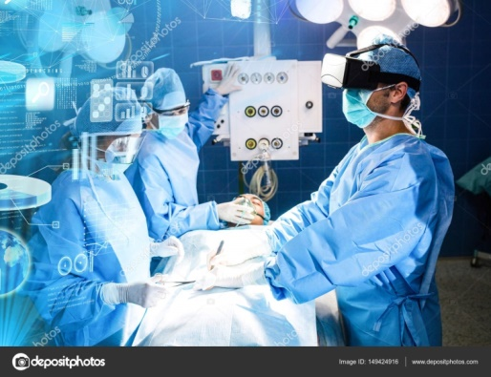

The Impact / Controversies of Scientific Breakthroughs2
  The advent of biotechnology and the resulting stem-cell research
  Medical breakthroughs
  Balancing benefits with Negative consequences
Notes:
The advent of biotechnology and the resulting stem-cell research:
Tissue engineering and stem-cell research.
Offer the promise that failing human organs and aging cells could be rejuvenated or replaced with healthy cells or tissues grown anew.
Medical breakthroughs:
In pharmaceutical care and medicine are occurring at a breathtaking pace.
→ Examples:
Surgery using 3-D glasses and a videomicroscope.
Delivering blood for transfusions by drone in Africa.
How to maximize the benefits to individuals and society yet minimize or eliminate the negative consequences regarding these technological developments must continue to be addressed?

Slide 15
The Role of Technology
Chapter 11
©2020 McGraw-Hill Education. All rights reserved. Authorized only for instructor use in the classroom. No reproduction or further distribution permitted without the prior written consent of McGraw-Hill Education.

